Slide 1
AN EDUCATIONAL PPT BY RAO MOHAR SINGH COLLEGE OF EDUCATION BEHRAMPUR,GURUGRAM
FOR D.EL.ED & B,ED COURSES
SUBJECT- CONTEMPORARY INDIA AND EDUCATION
TOPIC-Issues and Debates on Globalization, Liberalization and Privatization (Part-2) Presented by: Radha Yadav
Assistant Professor – Social Studies

Slide 2
LIBERALIZATION
LPG
PRIVATIZATION
GLOBALIZATION

Slide 3
Table of content:
Meaning of Liberalization
Objectives of Liberalization Policy
Different aspects of Indian Liberalization
Reforms taken during Liberalization
Impacts of Liberalization
Privatization
Key features of India's Privatization Process
Causes of Privatization in India
Objectives of Privatization
Six Industries which are not reserved for Private sector
Advantages of Privatization
Disadvantages of Privatization
Conclusion

Slide 4
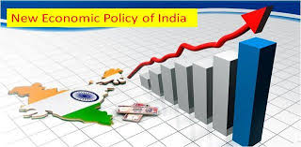
Liberalization
In simple words, liberalization refers to a relaxation of government restrictions in the areas of social, political and economic policies. In the context of economic policy, liberalization refers to lessening of government regulations and restrictions for greater participation by private entities.

Slide 5
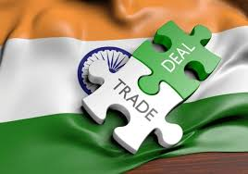
Objectives of Liberalization Policy
To increase competition amongst domestic industries.
To encourage foreign trade with other countries with regulated imports and exports.
Enhancement of foreign capital and technology.
To expand global market frontiers of the country.
To diminish the debt burden of the country.

Slide 6
Difference aspects of Indian liberalization
Subsides
Administered Price Policy Reform
Public Sector
Tax Reforms
Tight Control over Government Expenditure

Slide 7
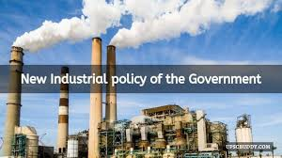
Difference aspects of Indian liberalization (Cont.)
Industrial Policy
Banking Sector Reforms
Capital Market Reforms
Foreign Investment Policy Reforms
Trade Policy Reforms

Slide 8
Reforms taken during Liberalization
Foreign
Investment
Capital
Market
Industrial
Policy
Reforms taken during Liberalization
Trade
Sector
Banking Sector

Slide 9
Impact of Liberalization
Positive Impact of Liberalization in India
Free flow of capital: Liberalization has enhanced the flow of capital by making it affordable for businesses to reach the capital from investors and take a profitable project.
Diversity for Investors: The Investors will be benefitted by investing a portion of their business into a diversifying asset class.

Slide 10
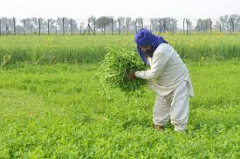
Positive Impact of Liberalization in India(cont.)
Impact on Agriculture: In this area, the cropping designs have experienced a huge change, but the impact of liberalization cannot be accurately measured. Government restrictions and interventions can be seen from production to distribution of the crop.

Slide 11
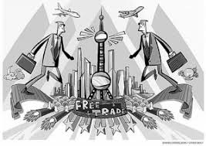
Impact of Liberalization
Negative Impact of Liberalization in India
The weakening of the economy: Enormous restoration of political power and economic power will lead to weakening the entire Indian economy.
Technological Impact: Fast development in technology allows many small scale industries and other businesses in India to either adjust to changes or shut their businesses.

Slide 12
Negative Impact of Liberalization in India(cont.)
Mergers and Acquisitions: Here small businesses are merging with big companies, therefore, the small companies employees may need to enhance their skilled and technologically advanced. This enhancing of skill and the time it might take may lead to non-productivity and can be a burden to the company’s capital.

Slide 13
PRIVATIZATION
Privatization means transfer of ownership and/or management of an enterprise from the public sector to the private sector .It also means the withdrawal of the state from an industry or sector partially or fully.

Slide 14
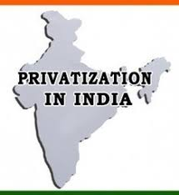
Key features of india’s privatization process
Contraction of Public Sector
Sick Public Sector Industries
Memorandum of Understanding-MOU
Sale of Shares of Public Sector to the Private Sector
National Renewal Fund
Implementing Recommendations of Rangaranjan Committee
Increase in Private Sector Investment in Planes
Withdrawal of Convertibility clause of Loans into Shares

Slide 15
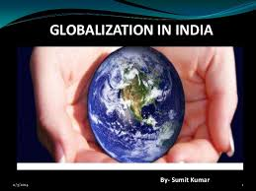
Causes of privatization in India
Disintegration of Socialist Economies
Inefficient public Sector
Uneconomic Price Policy
Burden on the Government
To Solve Financial Crisis of Government
Experience of New Industrial Nations of Asia
To Avail Benefits of Capitalism
For Promoting Industrial Growth
For Promoting Globalization

Slide 16
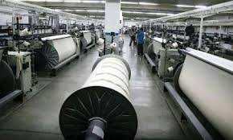
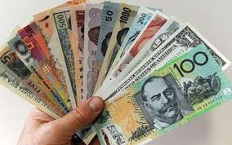
Objectives of privatization
To increase Efficiency and Competitive power of the Enterprises
To Strengthen Industrial Management
To earn more and more Foreign Currency
To make optimum use of Resources
To achieve rapid Industrial Development of the Country

Slide 17
industries which are not reserved for private sector

Slide 18
industries which are not reserved for private sector (cont.)

Slide 19
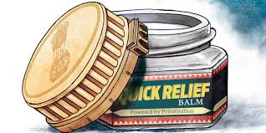
ADVANTAGES OF PRIVATISATION
Increase in Efficiency
Professional Management
Increase in Competition
Globalization of Economy
Increase in the Industrial Growth Rate
Increase in Foreign Investment
Reduction in the Loss of Public Sector Units

Slide 20
ADVANTAGES OF PRIVATISATION (cont.)
In-Line-with International Trends
Reduction in Economic –Burden of Government
Increase in Financial Resources of Government
Increase in Responsibility
Reduction in Public Interference
Encouragement to New Inventions

Slide 21
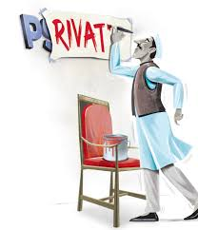
DISADVANTAGES OF PRIVATISATION
Industrial sickness.
Lack of welfare.
Class struggle.
Ignores Enterprises of national importance
Increase in Regional Imbalances.
Political Pressure.

Slide 22
DISADVANTAGES OF PRIVATISATION (cont.)
Increase in unemployment.
Ignores the weaker sections.
Increase in inequality
Opposition by employees.
Problem of financing.

Slide 23
Conclusion
The advent of Globalization as a result of Liberalization and Privatization ha both positive and negative impact on the economy. One group of people argue that globalization provides greater opportunities, new markets, better technology etc. while other group feel that it does not protect domestic industries. From Indian prospective globalization improved our condition of living open up employment in the field of IT, Telecommunication, Hospitality, Banking and others.

Slide 24
Thank you

